Slide 1
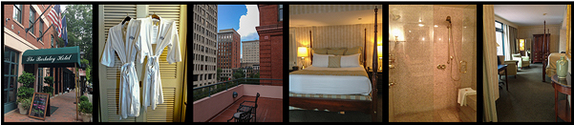
Hotel Recommender System
Sravanthi Ponnana
Metis Final Project, Sept 2016

Slide 2


Slide 3
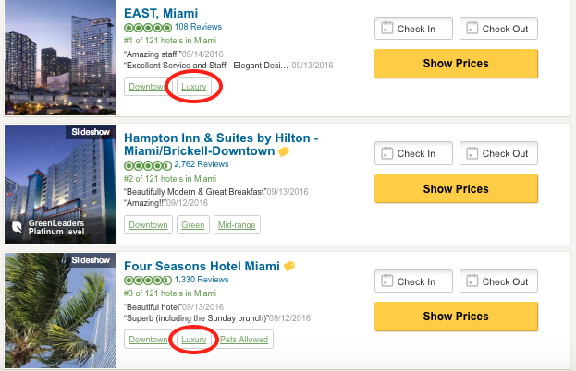

Slide 4
Objective: Build a Recommender System to Recommend Hotels on Tripadvisor

Slide 5








Tools

Slide 6
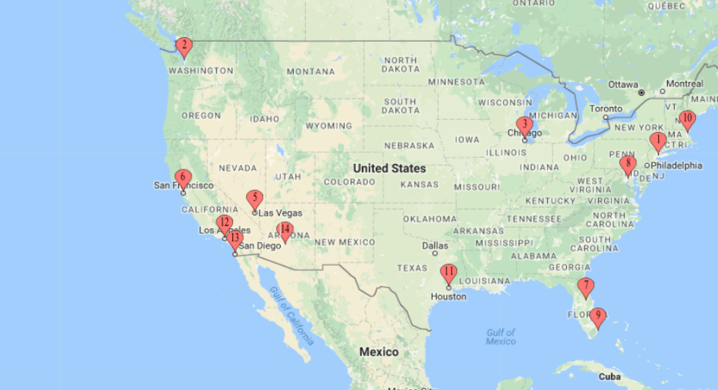
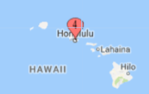
Data
Used Scrapy to scrape 400,000 reviews and ratings of 3300 hotels from Tripadvisor

Slide 7
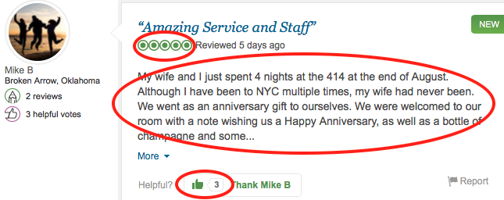
Inputs
Rating
Reviews
Helpful Votes
Services

Slide 8
Techniques
Item Collaborative filtering
Content based filtering

Slide 9





Item Collaborative Filtering
Hilton
John
Recommend
Users who liked Hilton
also liked JW Marriott
JW Marriott

Slide 10
Content Based Filtering
John
Hilton
Similar
Recommend
JW Marriott

Slide 11


Hybrid Recommendation System
Item Collaborative Filtering
Content Based Filtering

Slide 12
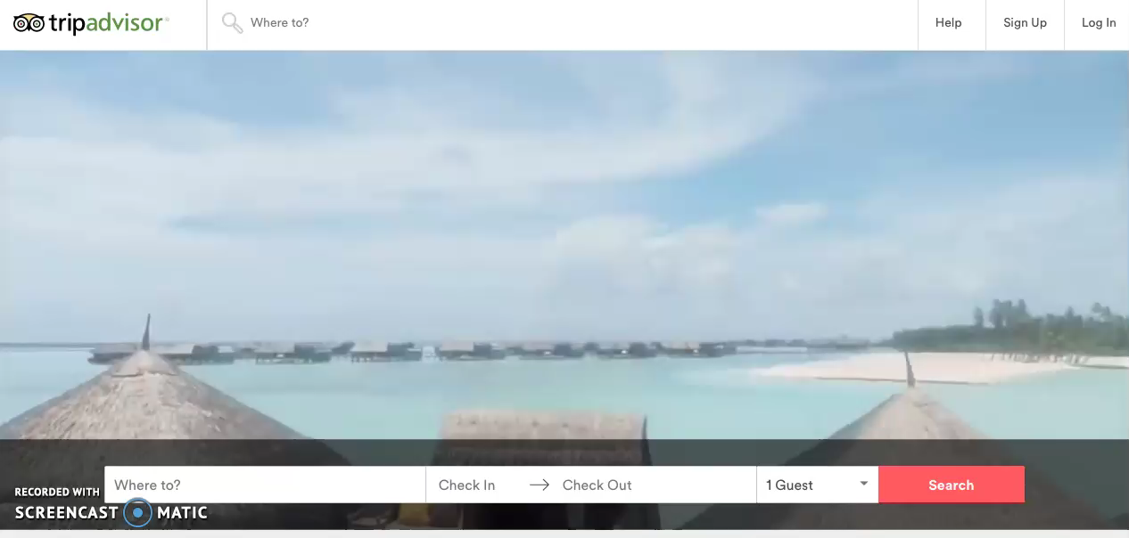

Slide 13
Future Work
A/B Testing
User Information - Demographics

Slide 14
Thank You!
Sravanthi Ponnana
E-mail: sravanthi.ponnana@gmail.com
Github: https://github.com/psravanthi/
Blog: https://psravanthi.github.io
LinkedIn: https://www.linkedin.com/in/sravanthip

